Slide 1

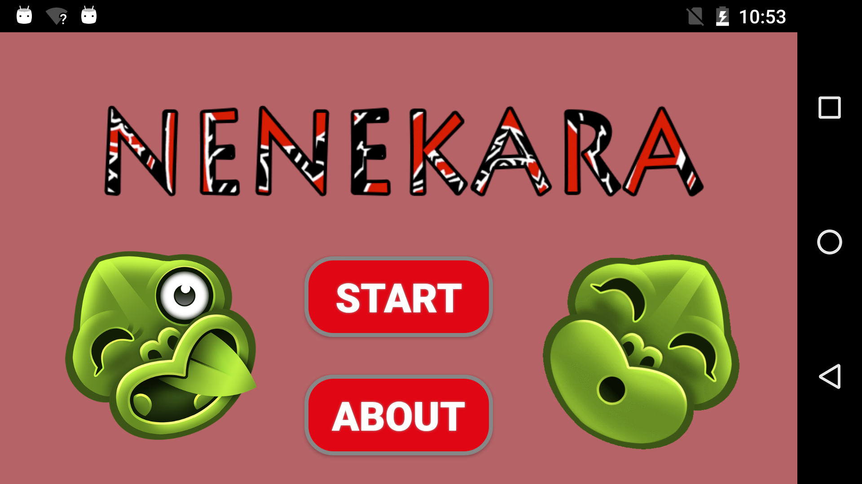






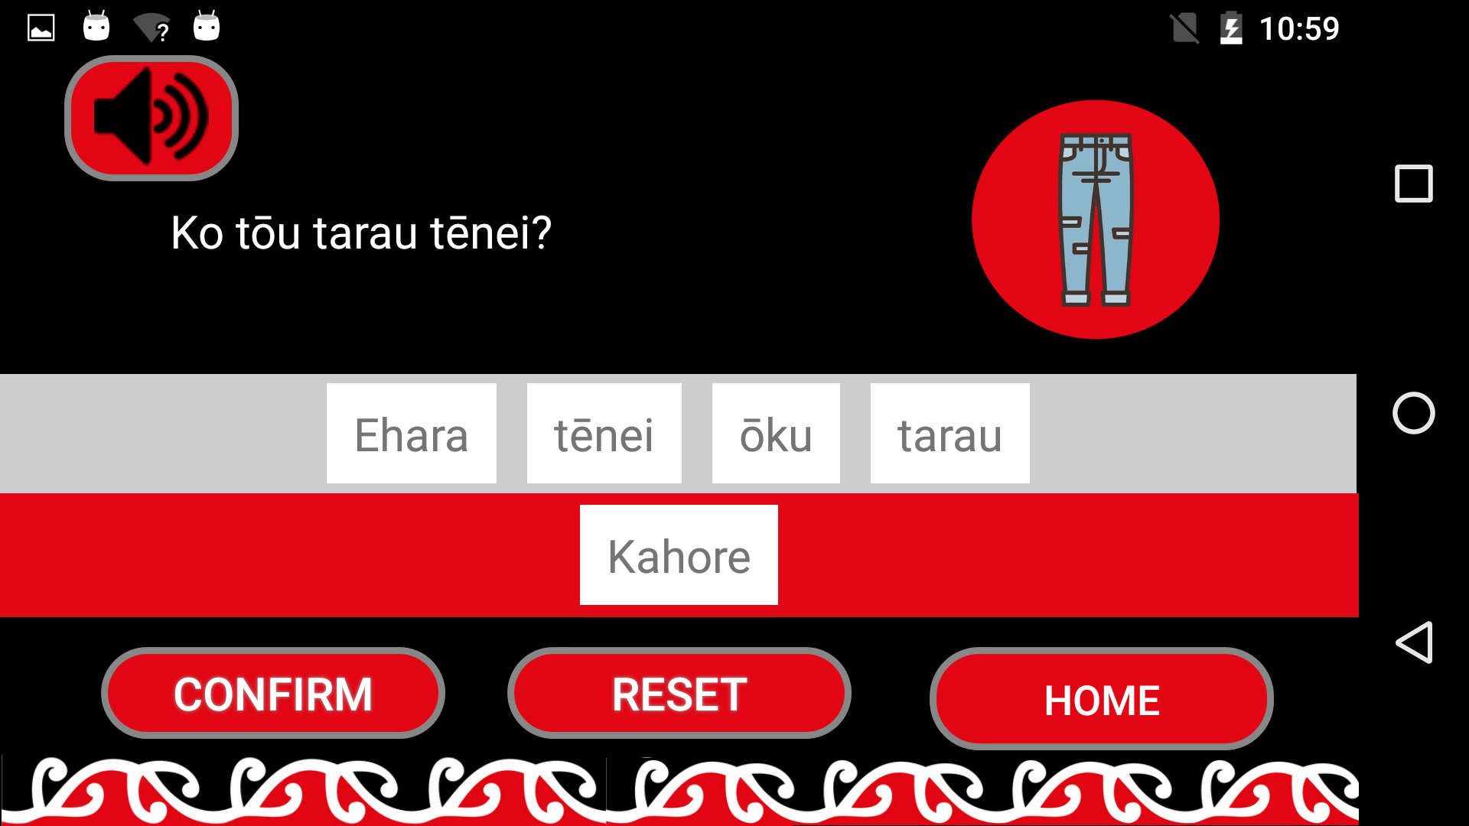
NENEKARA
Project Team:
Jayson Cocks
Marina Kerschbaumer
Patricia Nellas
Supervisor: Kevin Shedlock
Client: Eruera Ruwhiu
TE REO APP
BACKGROUND
PROJECT OUTCOME
TECHNOLOGIES
Established in the 1980s, Te Wānanga Māori is one of the first faculties of Whitireia Community Polytechnic and is made up of three departments: Māori Art, Nursing, and Te Reo Māori. The client for this project is the Reo Māori school.
THE PROBLEM
Android Studio 3.1.4
SQLite
Whitireia’s GitLab
GitHub
Google Drive
Slack
One consistent problem our client has noticed is that students have a problem differentiating between the use of ehara and kahore in negative sentences. Both words are used in traditional Māori to indicate the negative, however they are not interchangeable.
CONCLUSION
Figure 2. Nenekara Main Menu
OBJECTIVE
Over the course of the semester the team has created a working prototype that meets the client’s objective of allowing students to practice the difference between ehara and kahore. This includes the design and implementation of a user-interface, the database, and code. The prototype forms a solid foundation on which the next team can further improve and add functionality.
The objective of our Android application is to provide a means for users to improve their learning of Te Reo sentence structures, specifically negative sentences using ehara and kahore. This aim of the application is to provide students with a portable resource that can be easily accessed and that complements existing classroom resources.
RECOMMENDATIONS
METHODOLOGY
Figure 3. Sentence Structure Example
Refine
The following recommendations are made to further develop the application:
Incorporate sentence categories, images and audio files into the database.
Carry out usability testing with the target users of the system (i.e. Whitireia’s Māori language students)
Modify the drag and drop functionality so that users can reposition words in the answer panel.
Test and develop the application for a broader range of devices.
Add levels of difficulty to the application.
Investigate providing a tutor interface, so they can add their own sentences and keep content relevant to students’ learning needs.
Demonstrate
Demonstrate
Initial Requirements
Develop
The front-end and back-end of the application was created using Android Studio. The current database which was designed using Android Studio’s plugin tool, SQLite, contains three sample sentences provided by our client. At this stage, the audio files and images have been hardcoded into the application.
Our final prototype was designed in a way to allow future iterations of this project to add new sentence structures (categories) and new functionalities to further improve it.
Prototype
Cycle
Testing
Deployment
Figure 1. RAD model
The methodology used for this project was RAD (Rapid Application Development) with Kanban. It was decided RAD was suitable for this project as it emphasises rapid prototyping and iterative delivery rather than extensive planning. The prototyping was done in multiple iterations with new functionalities and features added at each iteration.

